Slide 1
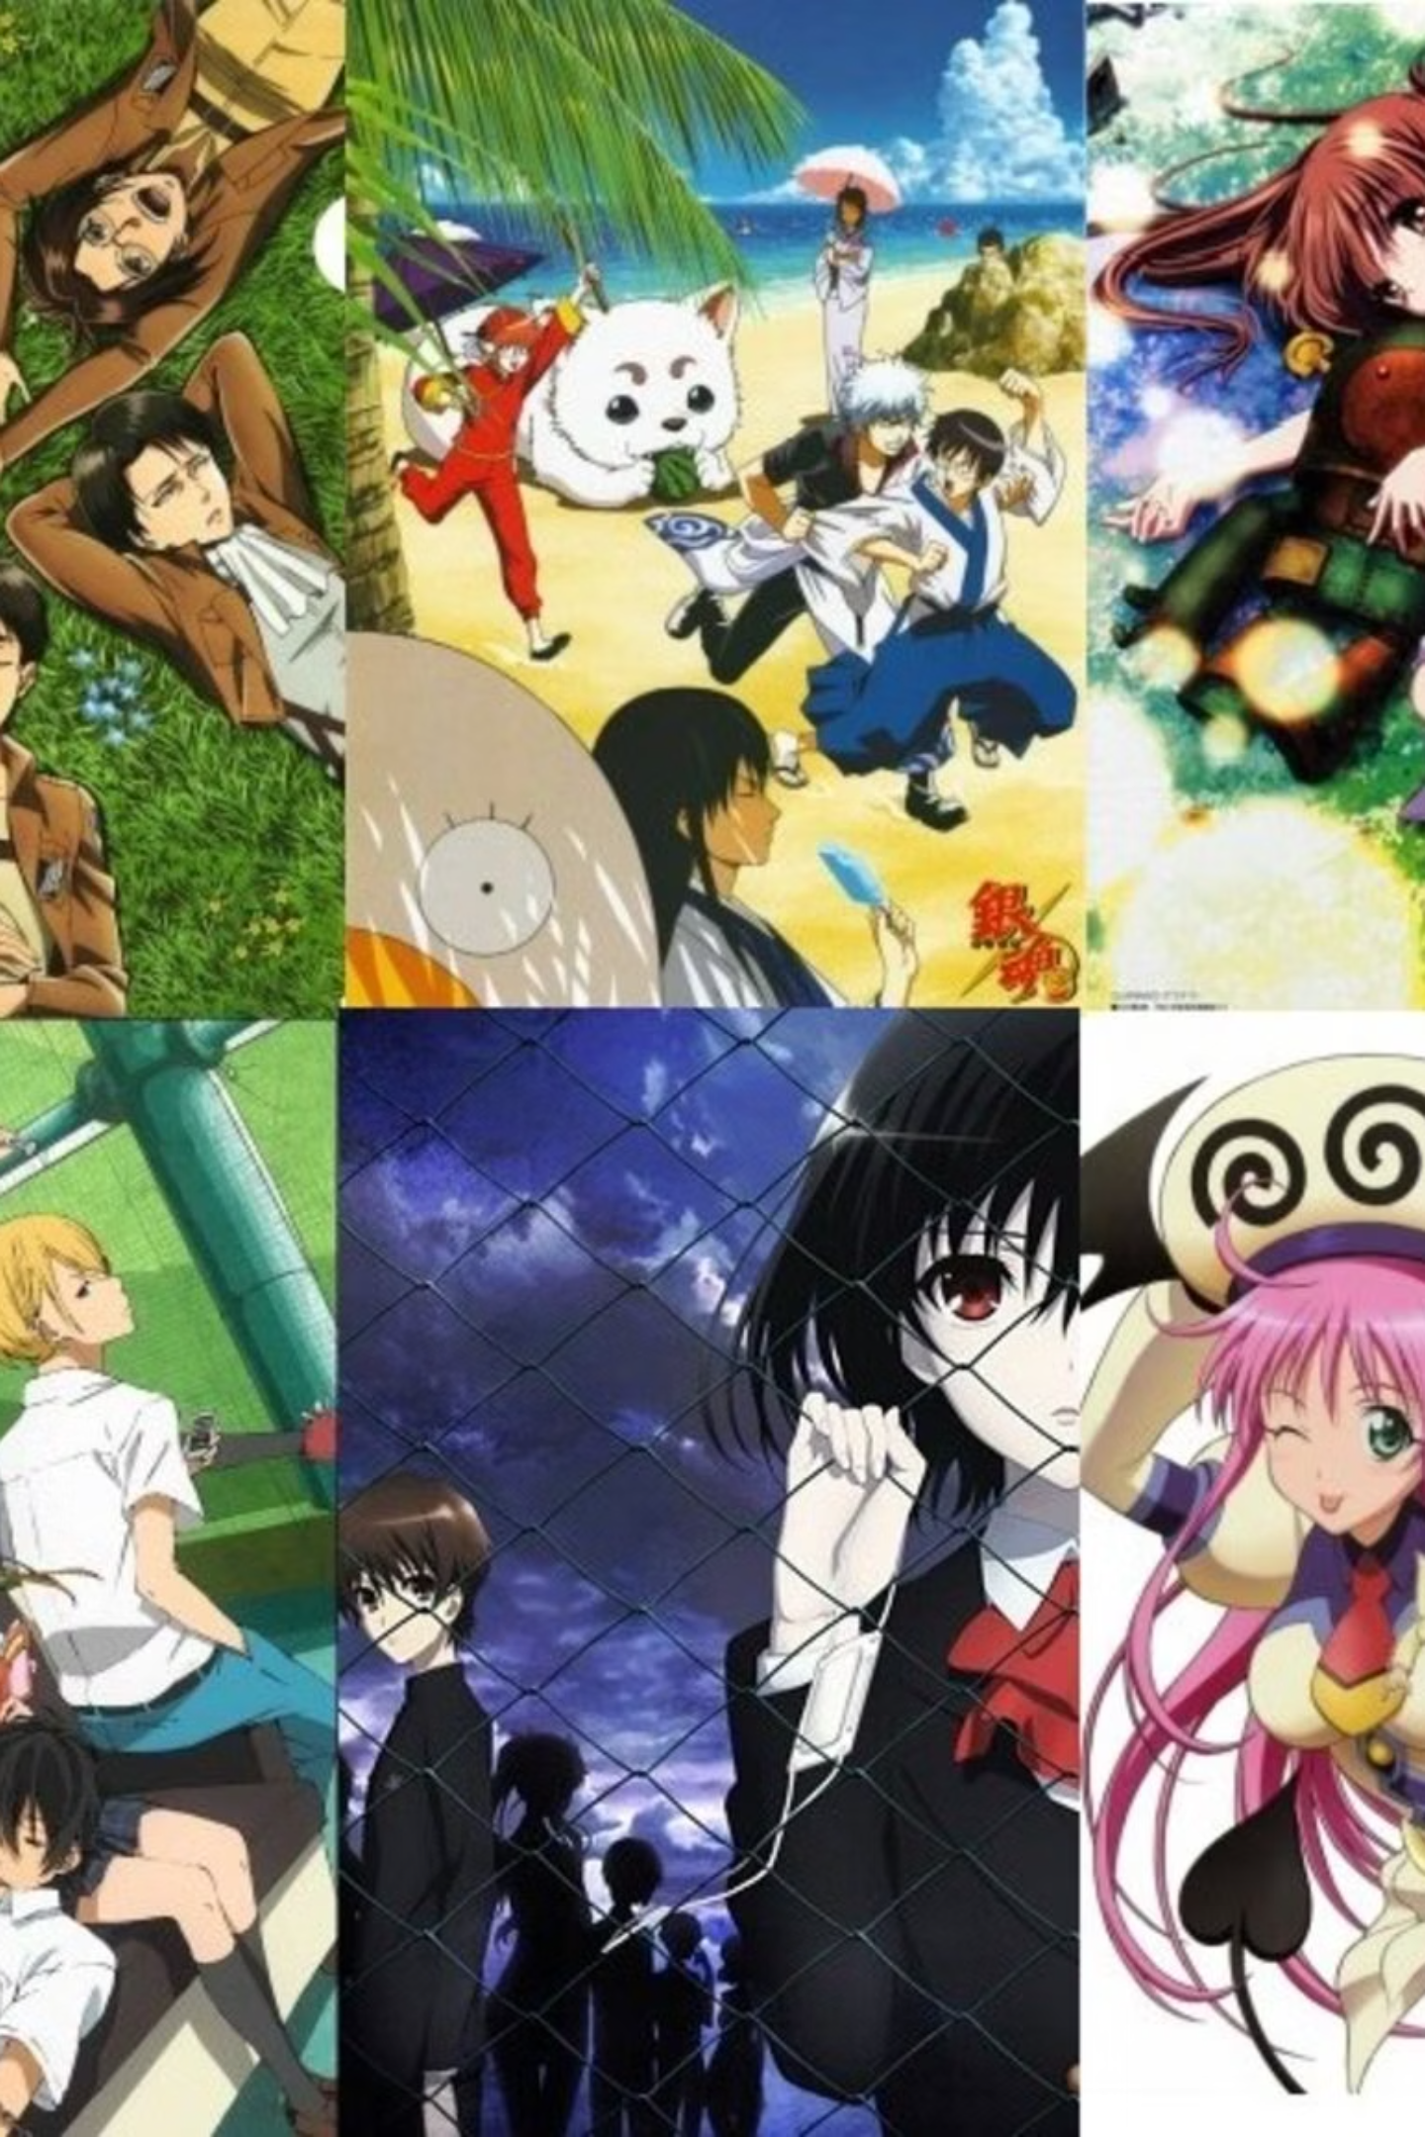
Exploring Anime Genres: A World of Stories
Shonen: Action & Adventure
Shojo: Romance & Drama
Targeting young male audiences, Shonen anime often features high-energy action, strong friendships, and personal growth. Popular examples include "Dragon Ball" and "One Piece."
Aimed at young female audiences, Shojo anime explores themes of romance, relationships, and emotional development. Classics include "Sailor Moon" and "Fruits Basket."
Seinen: Mature & Thought-Provoking
Catering to adult males, Seinen anime delves into complex narratives, psychological depth, and often darker themes. "Attack on Titan" and "Berserk" are notable examples.

Slide 2
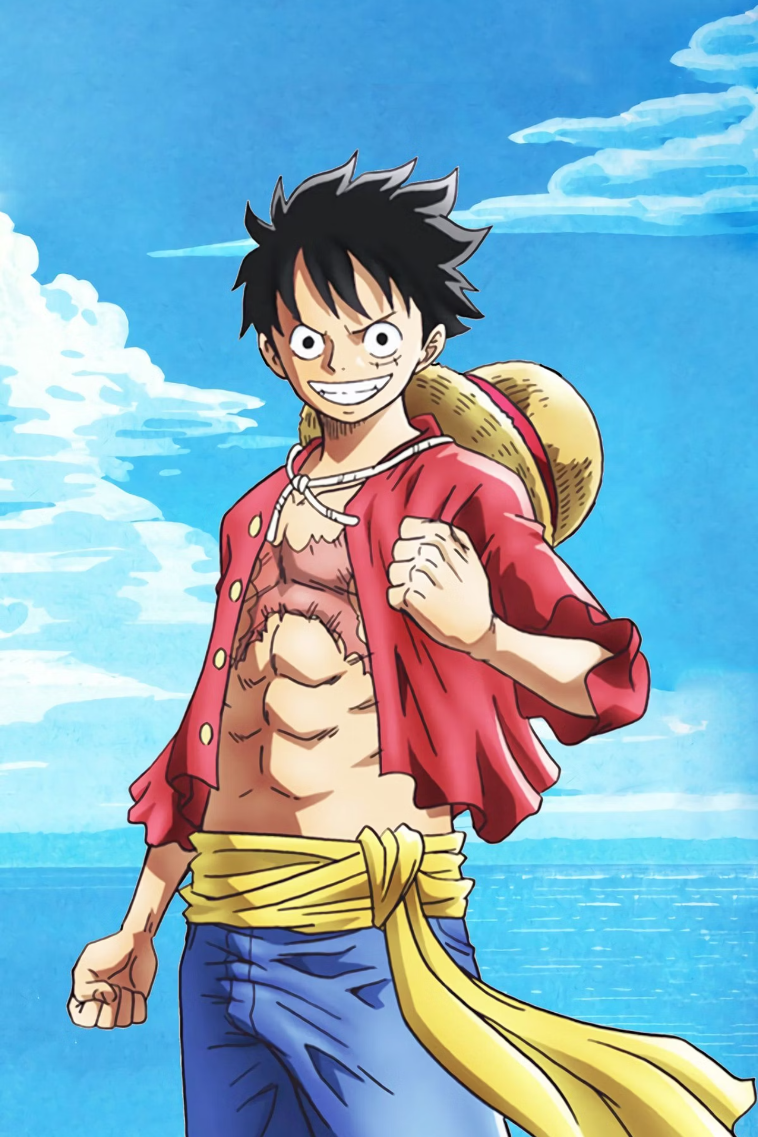



Genre Spotlight: Shonen - Action and Adventure
Target Audience
Shonen anime is primarily targeted at a young male demographic, typically ages 12-18.
Core Themes
It focuses on friendship, perseverance, and overcoming challenges. Stories often involve intense battles.
Top Example: One Piece
One Piece sold over 500 million manga copies by 2022. Its 2022 film, One Piece Film: Red, was the highest-grossing anime film of the year globally, earning $197M. It's celebrated for its expansive world-building.

Slide 3
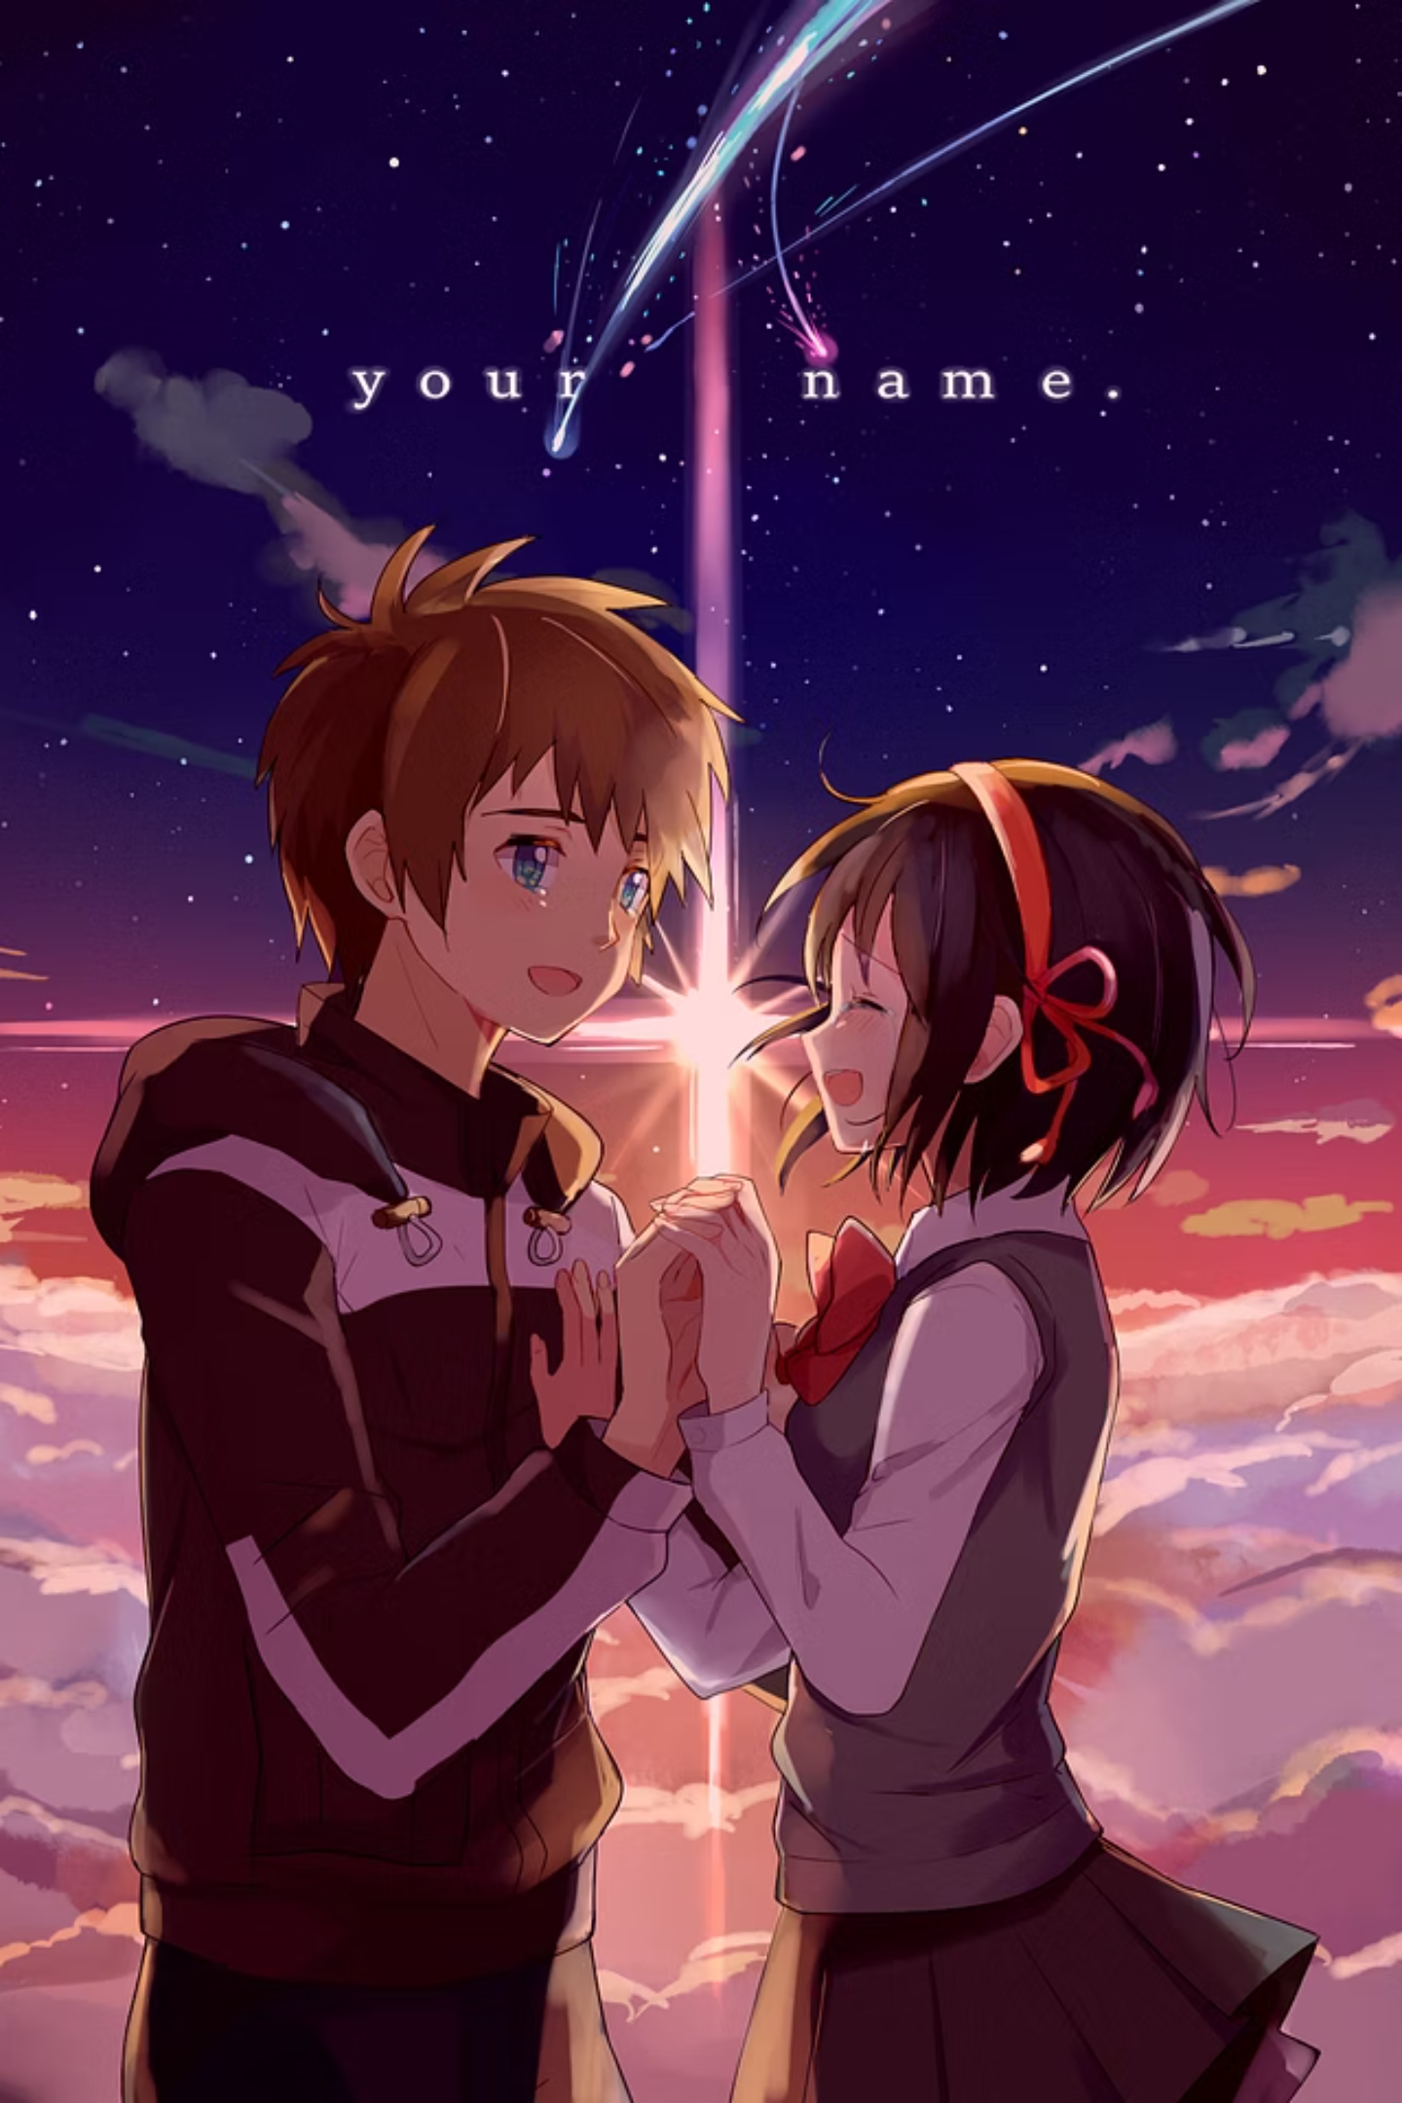



Genre Spotlight: Shojo - Romance and Relationships
Target Audience
Shojo anime is aimed at a young female demographic, generally ages 12-18. It explores complex emotions.
Key Elements
It often features personal growth and interpersonal bonds. Romance is a central theme.
Top Example: Sailor Moon
Sailor Moon revitalized the magical girl genre in the 1990s. It became a global cultural icon, recognized for empowering female characters. Its influence extended to Western pop culture, inspiring shows like "Steven Universe" and "She-Ra."

Slide 4
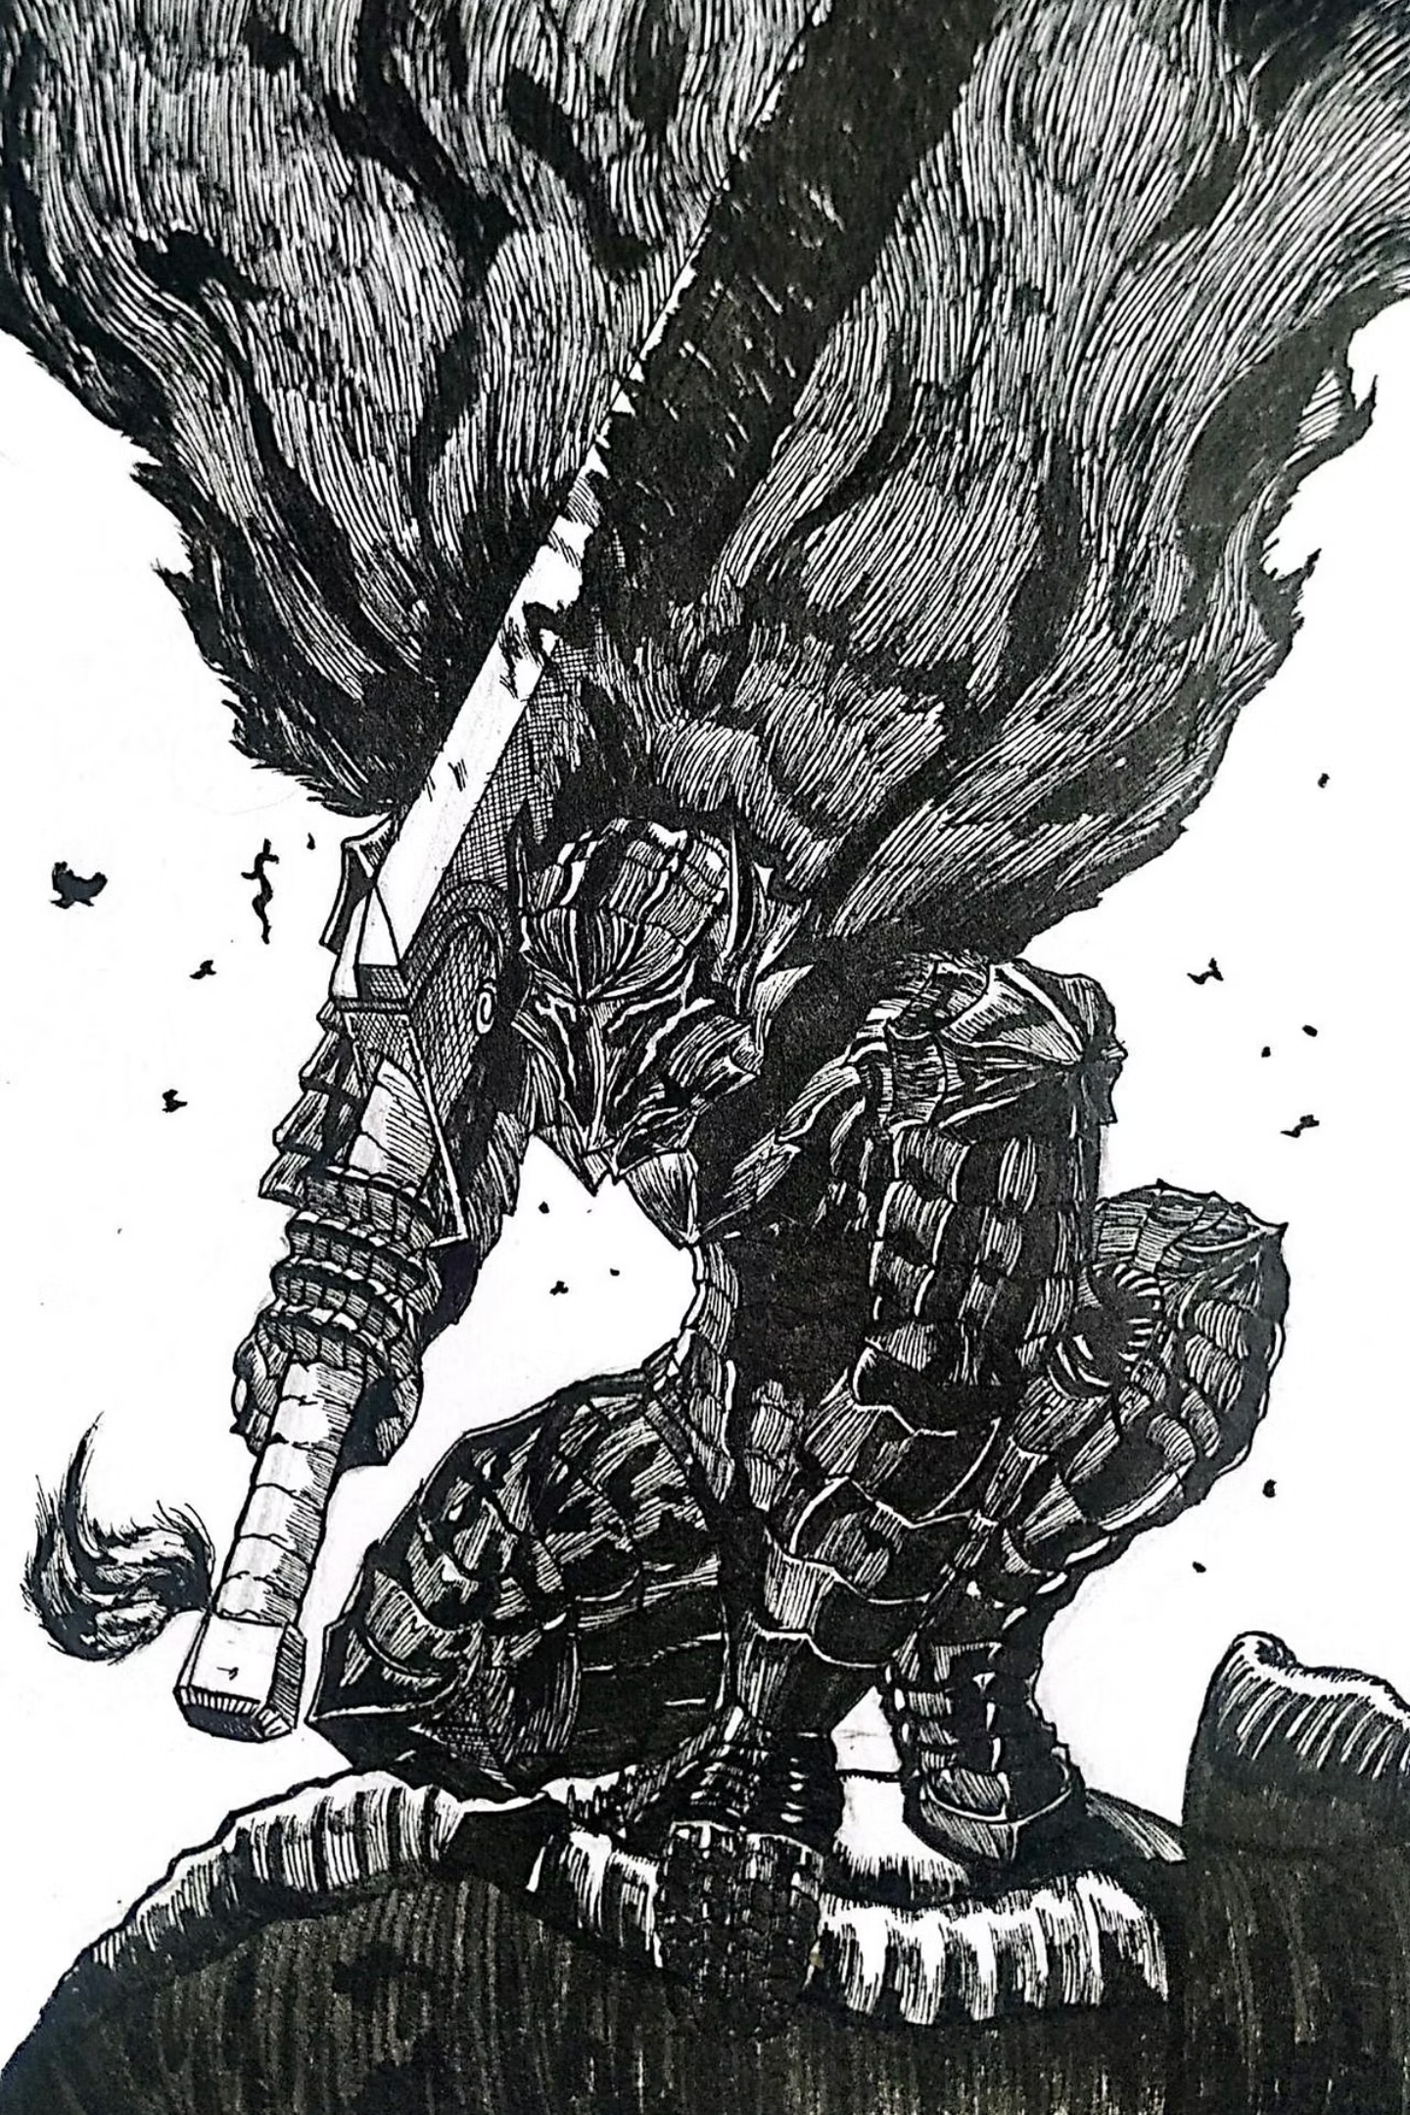



Genre Spotlight: Seinen - Mature and Thought-Provoking
Target Audience
Seinen anime targets an adult male demographic, aged 18 and older. It explores mature themes.
Narrative Depth
Often features darker themes, psychological depth, and complex narratives. Storytelling is intricate.
Top Example: Berserk
Berserk is critically acclaimed for its dark fantasy setting and philosophical themes. It influenced numerous video games and Western fantasy works. The series is inspired by medieval European aesthetics and existentialism.

Slide 5
The Ghibli Phenomenon: A Timeless Aesthetic
Studio Ghibli was founded in 1985 by Hayao Miyazaki, Isao Takahata, and Toshio Suzuki. It is renowned for its hand-drawn animation and rich world-building. Their films feature profound narratives.
The recent "wave of Ghibli images" online reflects an enduring aesthetic appeal. Their visuals are popular on Pinterest and Tumblr for being "cozy" and evocative. Miyazaki's How Do You Live? won the Golden Globe for Best Animated Film in 2024.

Slide 6
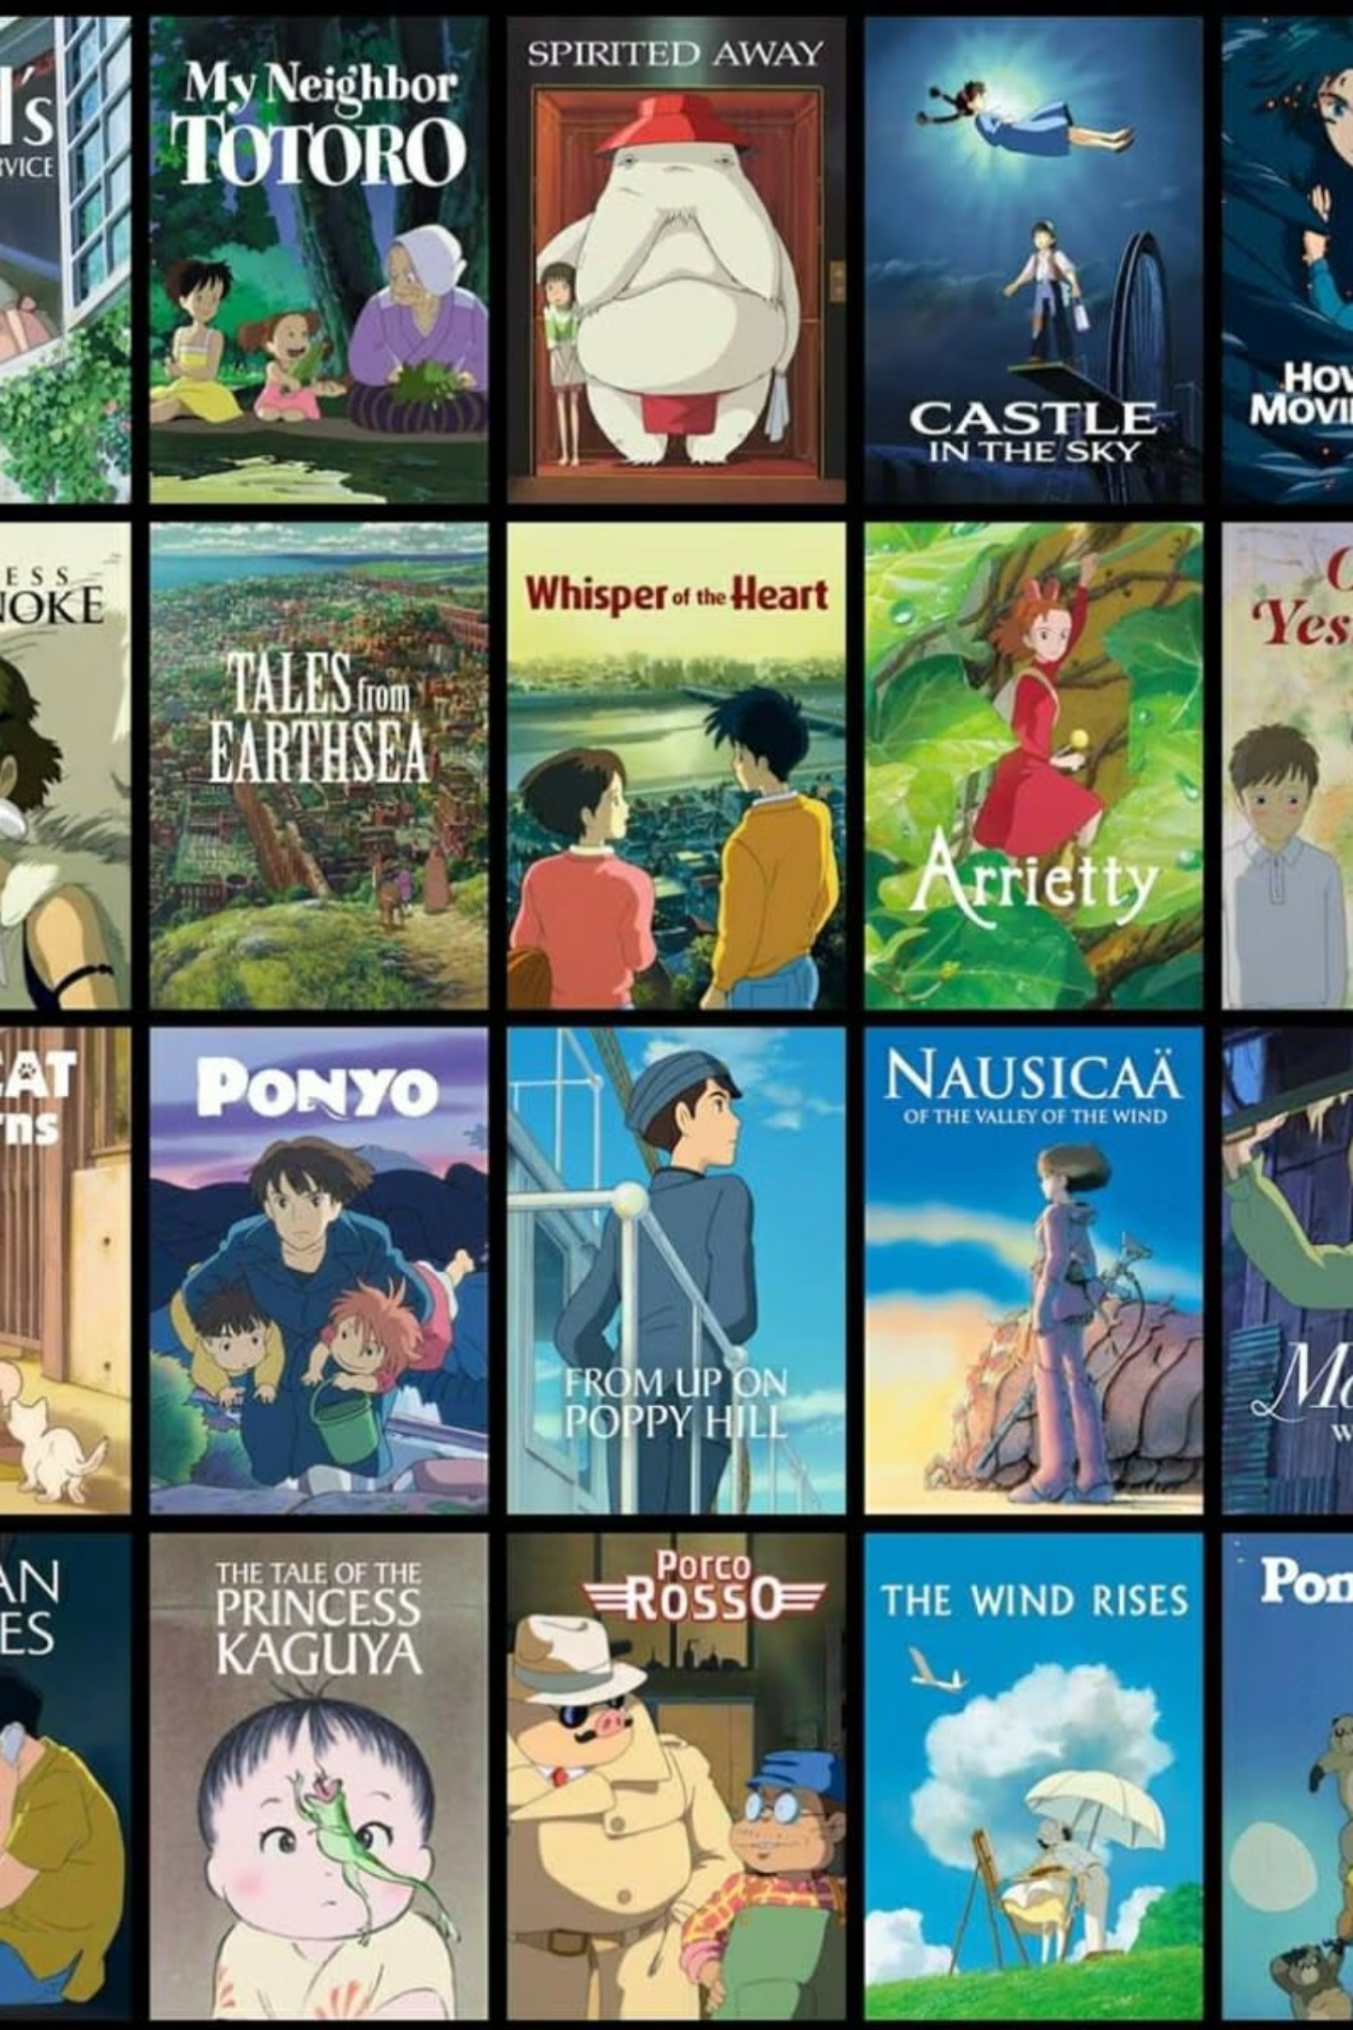



Studio Ghibli's Enduring Legacy
Spirited Away (2001)
Won Oscar for Best Animated Feature (2003). It was the highest-grossing Japanese film globally for years, earning $395.8 million.
Princess Mononoke (1997)
Explores environmentalism and human-nature conflict. It was the first animated film to win the Japan Academy Prize for Best Picture.
My Neighbor Totoro (1988)
A beloved family film, its character "Totoro" is a global brand ambassador. Celebrated for its innocence and wonder.

